Slide 1
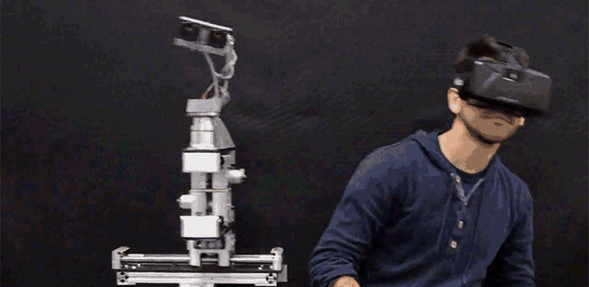
Educational Lab in Vr
Team Members: Omar Irfan Khan, Mohammad Eyad Masoud
Senior design Advisor: Dr. Abdul Halim Jallad

Slide 2

Outline
Background
Problem Definition
Design Specification
Results
Costs
Conclusion

Slide 3
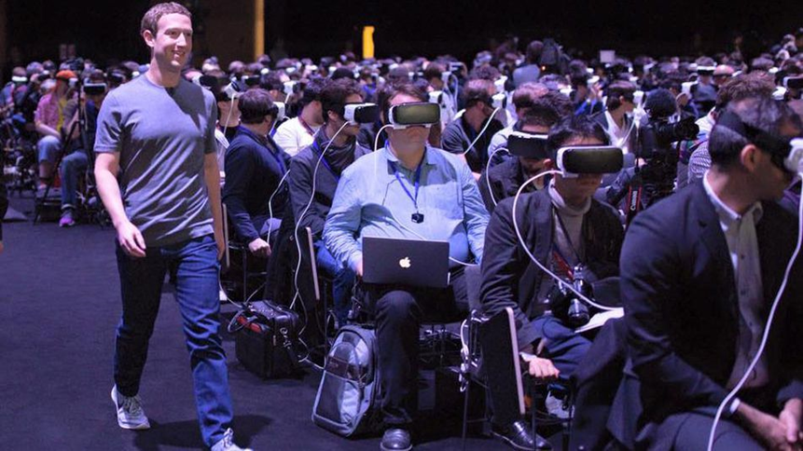

Background
Three different types of realities
Virtual Reality (VR)
Augmented Reality (AR)
Mixed Reality (MR)

Slide 4
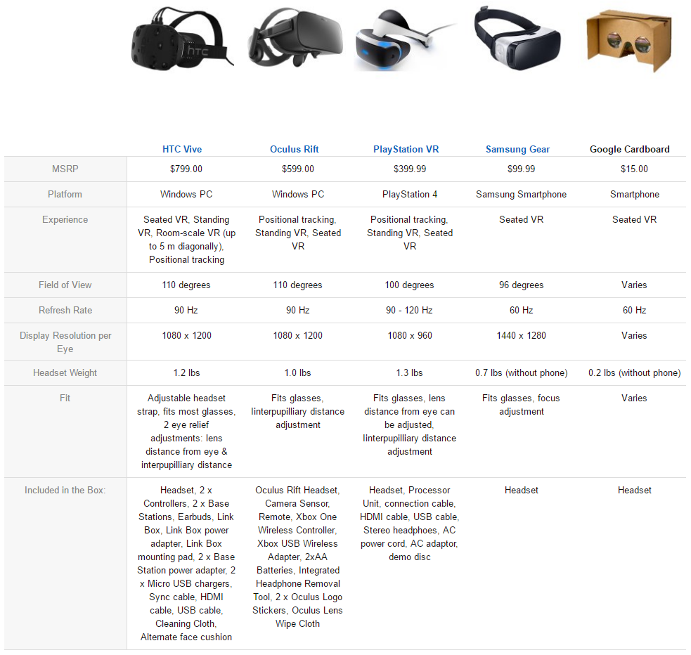
Background (VR)
Virtual Reality (VR) is the use of computer technology to create a simulated environment
VR tries to simulate as many of our senses as possible such as vision, hearing, touch and even smell.

Slide 5


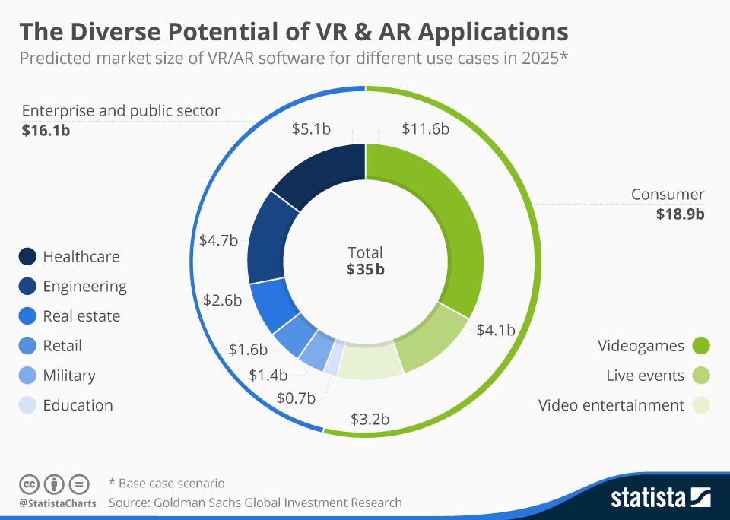
Background (AR)
AR adds an overlay of data over the real world.
The data could be in various forms such as filters, notifications or numbers.

Slide 6
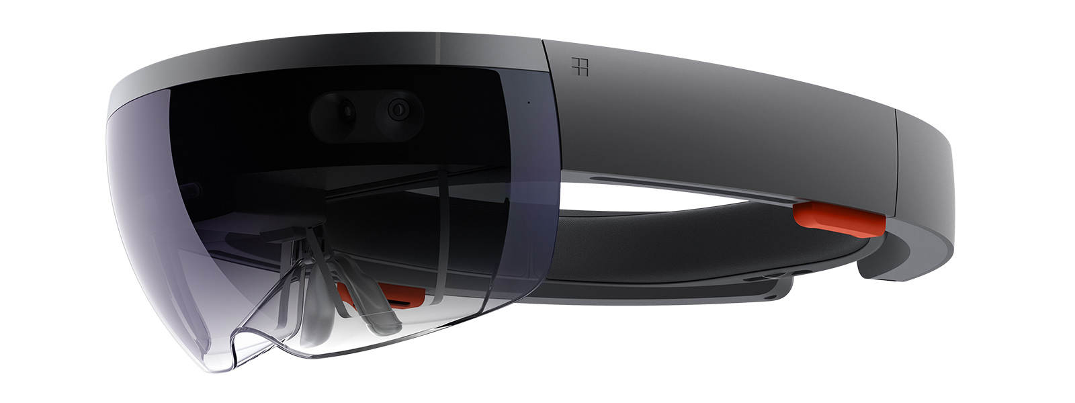
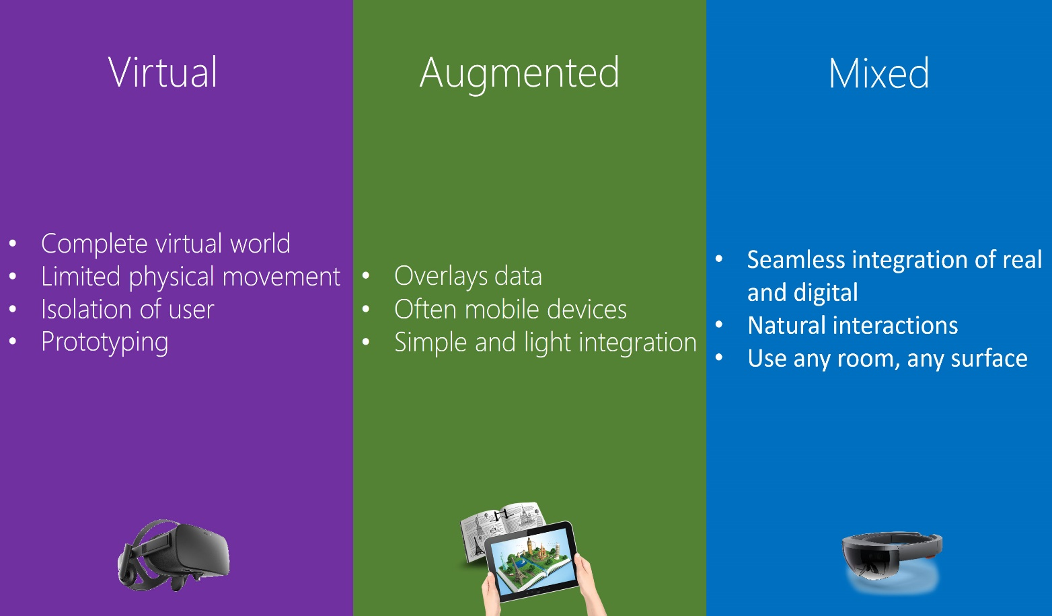
Background(MR)
MR is the best of both worlds.
Uses both AR and VR characteristics.
Least commonly known between the two.
Notes:
1st point it combines both features of AR and VR together. MR would allow the user to see the real world but at the same time see virtual objects fixed to a point in space. So whenever the user would move close to that object it would show the object closer.

Slide 7
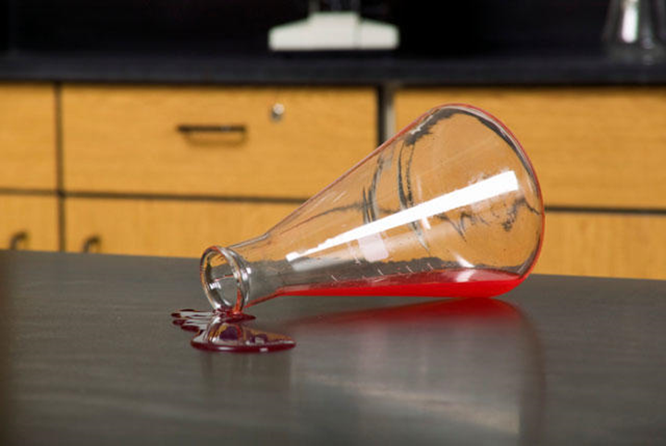
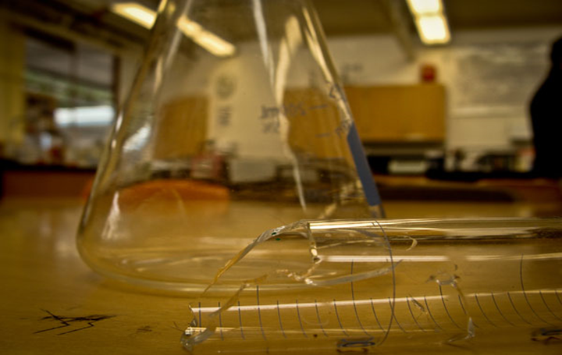
Problem Definition
Explore the suitability of using VR in health and safety.
Everyday there are incidents that occur in a chemistry lab. Most of the students do not know what to do in such cases as professors may not have briefed students about safety.
We aim to change this by making students more aware about health and safety practices that should be followed by students in a chemistry lab.
Notes:
1st point vr is often associated with gaming and military use. Until recently people started exploring other areas for the possible use of VR. One of the possible uses of VR is in education

Slide 8
Design Specification
The design of the laboratory is divided into 3 components:
Game Engine
Object/Asset Creation
Audio Effects

Slide 9
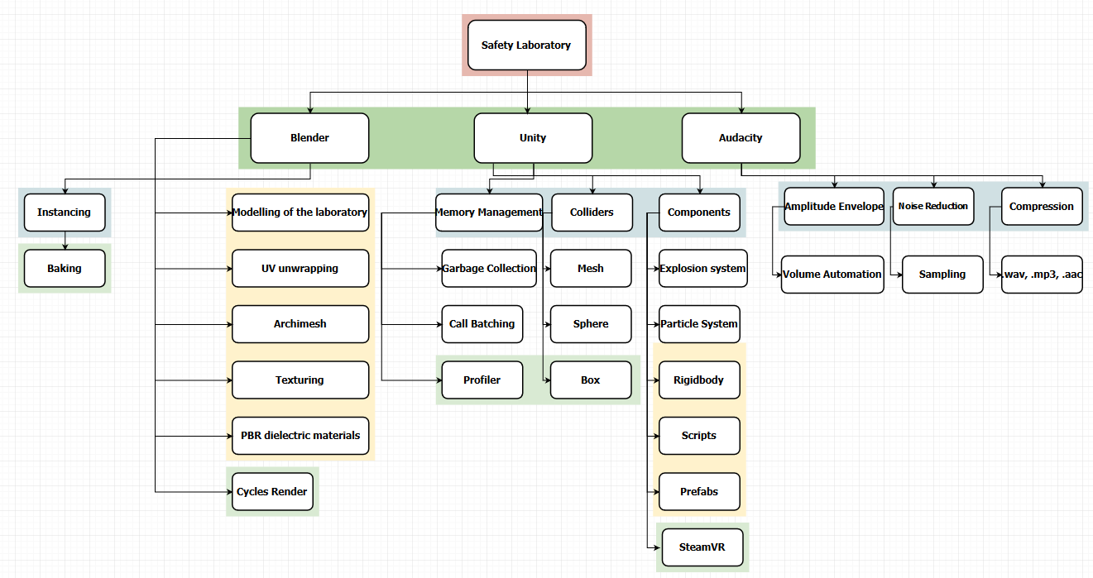
Flowchart of components

Slide 10


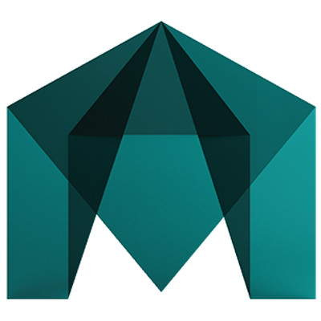
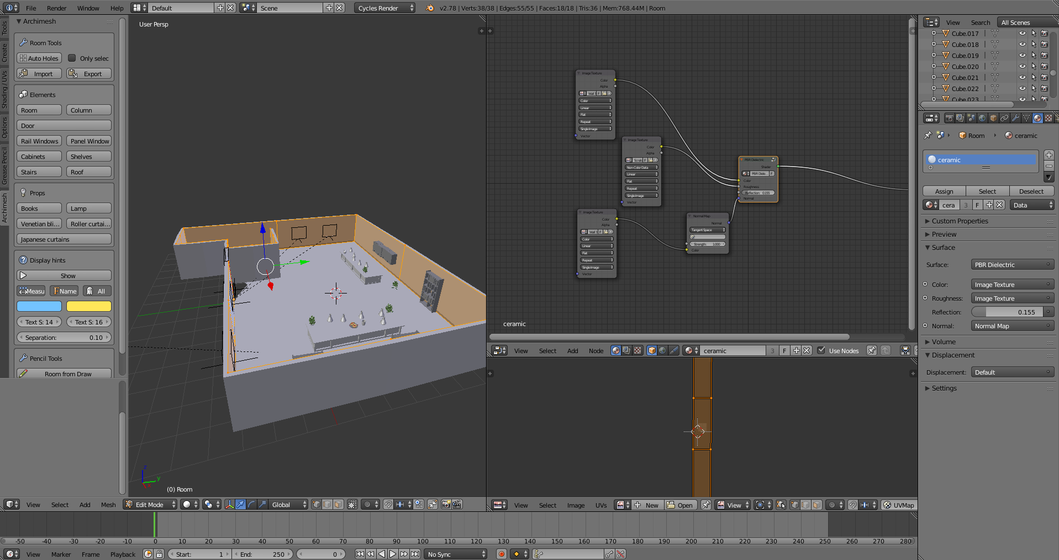
Object/Asset Creation
Use blender to create the apparatus and export it to the game engine
Blender boasts photorealistic rendering, fast rigging, UV wrapping, fluid and smoke simulation etc.
Alternatives: Maya, Zbrush and Sculptris
Notes:
We modelled in blender using a plugin called archimesh which made it easier for us to create walls,doors,windows,floor texture and much more on a single click of a button. After desiging the laboratory we exported a number of objects such as shelves, books, cabinets from prop sites such as turbo squid,tf3dm or blendswap. After creating the laboratory we exported all the assets to unity in a .fbx file . We could of ofcoure used one of the alternatives to model our laboratory but Zbrush and Maya are paid. So that leaves us only with blender or sculptris. Blender does most of the jobs that maya can do such as fast rigging, uv unwrapping, baking and more.

Slide 11
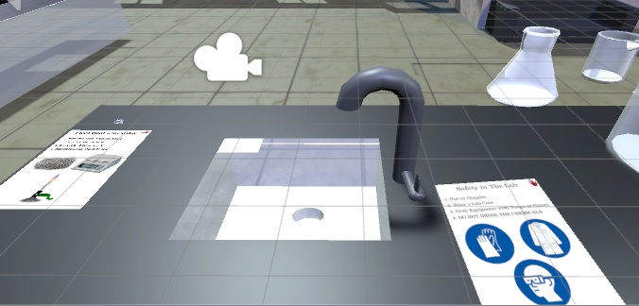
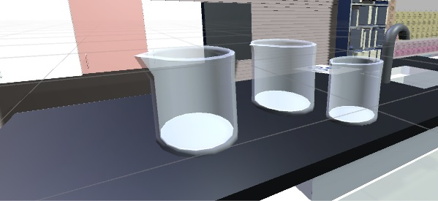
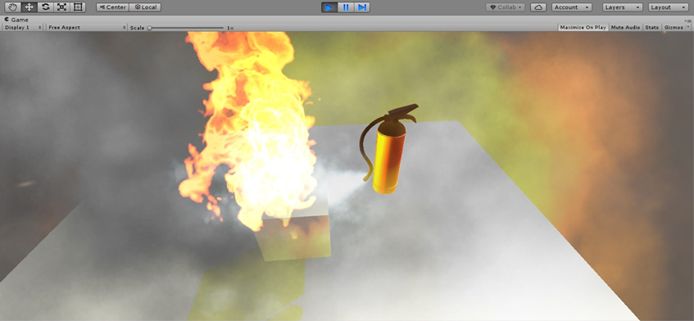
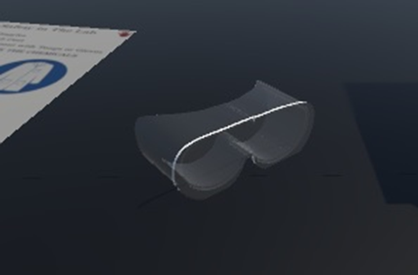
Object/Asset Creation
Notes:
We created more assets for the lab such as beakers to store liquid , marble tables, faucets with shuriken particle systems attached, safety goggles that the user can wear and a fire extinguisher which we obtained from the unity asset store.

Slide 12
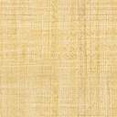


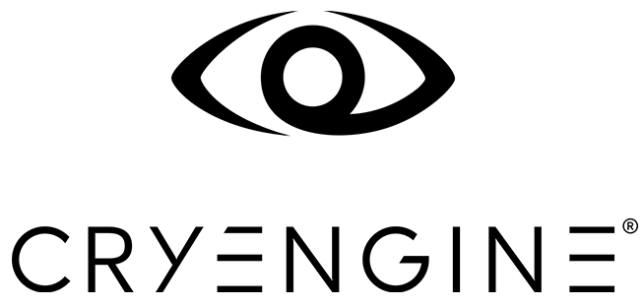
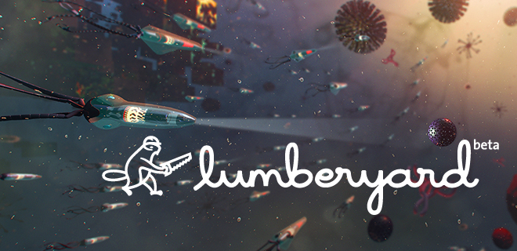
Game Engine
Unity has a great asset store and provides real time global illumination and has a built in audio mixer.
Unity uses C#, JavaScript and boo where as Unreal uses unreal script and is mainly used for blueprint making.
Alternatives: CryEngine, Amazon Lumberyard or Unreal.
Notes:
Unity uses C#, JS and boo while unreal uses C++ and unreal script which is derived from java and mainly used for blueprint making

Slide 13
Unity vs Unreal
Unity | Unreal
Supports 21+ platforms (PC, Console, Mobile, Web) | A visual scripting system for non-coders enables quick prototyping
Elaborate documentation is provided | Supports approximately 6 platforms (Mainly PC and Consoles)
Loads of official & community tutorials out there | Has a history of being one of the nicest looking engines
Free if you make <$100K from it | Mediocre documentation
Easy for programmers, Easy for designers | Lots of tutorials if you are a designer, very little for coders
Great for building any kind of game | Free if you make $<$50K from it
Flexibility is provided by a strong component programming model | Built from a FPS, which makes it a lot harder to do non FPS games
Works with 3rd party IDEs | Developers have full control of the engine and source code
Offers choice of scripting languages | Quick release-cycle
Has a great animation system | Slow and very high build size

Slide 14


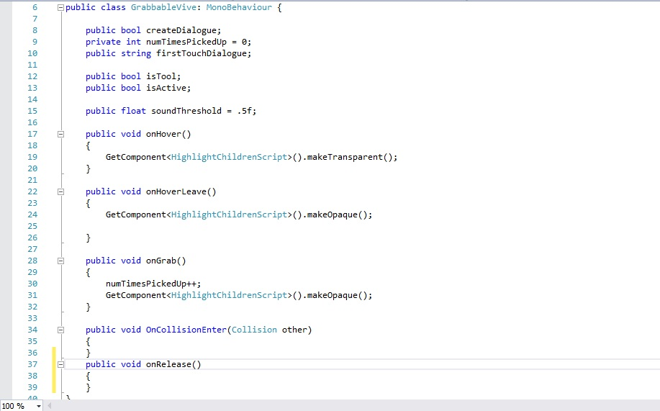
Game Engine
To enable interaction with the vive controllers you need to add certain elements to the object.
There are toolkits available online to allow interaction, more accurate physics representation and more.
Notes:
Rigidbody, Appropriate colliders (depending on the object you can add 2 main types of colliders primitive colliders and mesh colliders.) and most importantly an appropriate script. NewtonVR

Slide 15


Audio Effects
Sounds were added for various objects such as when boiling water.
Audacity was used to filter out noise from sound samples

Slide 16
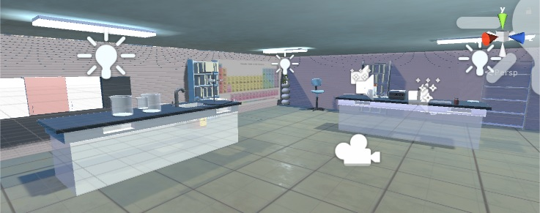
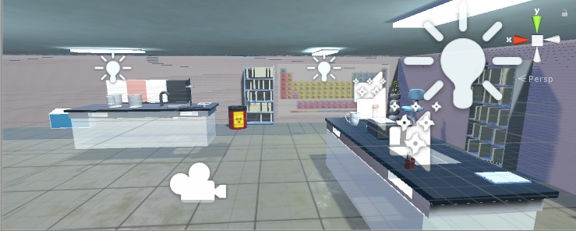
Results
Made a working chemistry laboratory where a user can perform various experiments without taking caution.

Slide 17
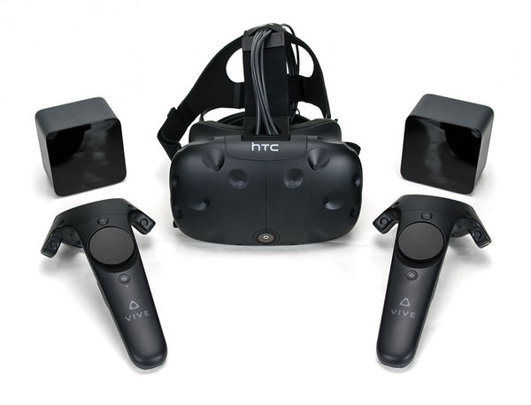
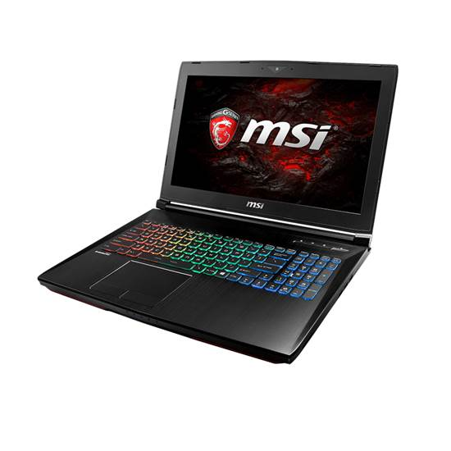
Costs and specification
Component | Cost
HTC Vive : Display : OLED Resolution : 2160 x 1200 Platform : Steam VR Controller : Vive controller Tracking area : 15 x 15 feet | 3800 AED
VR ready laptop: MSI GT62 VR 6RE DOMINATOR PRO, VR READY 32 GB RAM , 1 TB HARD DISK Nvidia GeForce® GTX 1070 8 GB GDDR5 , Intel Core i7-6700HQ Quad Core Processor (2.6-3.5GHz) | 8999 AED

Slide 18
Conclusion
We were able to achieve a fully functioning laboratory where the students can perform various experiments.
Students can perform experiments with ease in there own home.
VR has a long way to go to be accepted in areas such as education, training for various jobs and medicine.
Notes:
The incorporation of VR has shown us that VR can be successfully used in education to teach students .

